Slide 1

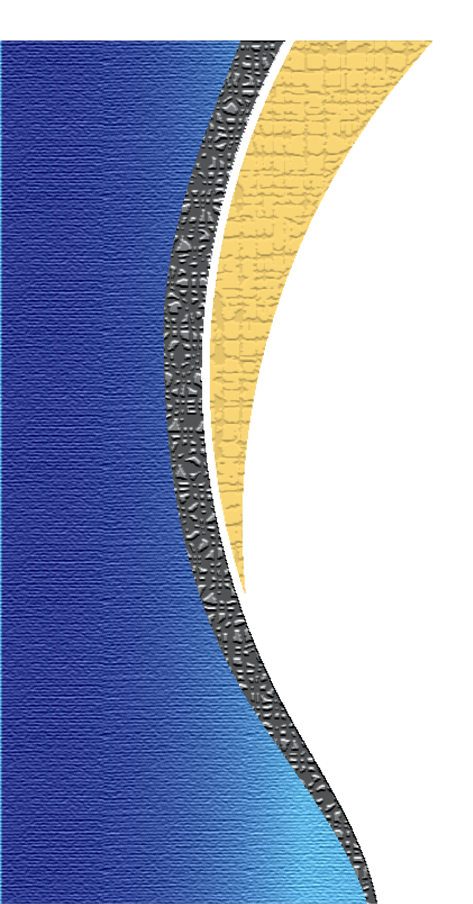
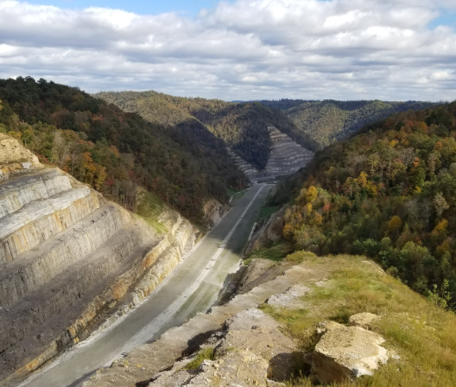
Designing Rock Cuts and Slopes Using ORD
Times 10:50-11:30 and 3:50-4:30
Kevin Damron – Palmer
Chelsea DeWitt - Palmer
Patrick Stone - KYTC
Notes:
Skip to next slide

Slide 2
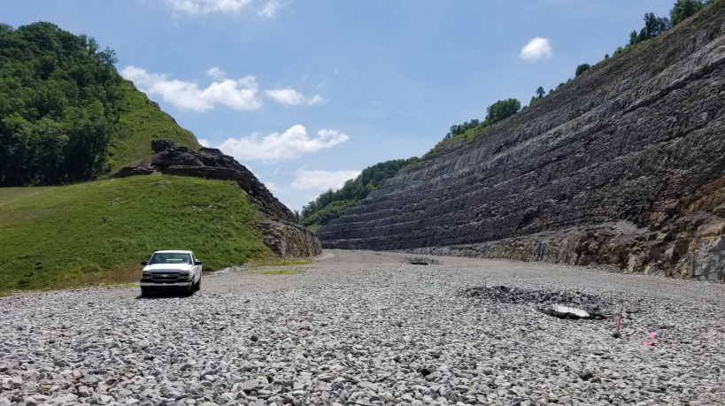
Intro
Approximately 40 minutes of presentation/discussion broken down into three sections.
  Geotech Update, Geotech Terrain challenges and Emerging Solutions.
  How Palmer is Designing Rock Cuts, Slopes and RDZ in ORD On the Mountain Parkway.
  Questions ?
Notes:
I am Patrick Stone I work for KYTC Structures. This presentation will last 40 min . I will be giving the Geotech update ,along with Emerging Solutions. 5 Min or less.
Then I will turn it over to Palmer to show how they are design rock cuts , slopes and RDZ in Ord on The Mountain Parkway.
Then we will take questions.

Slide 3
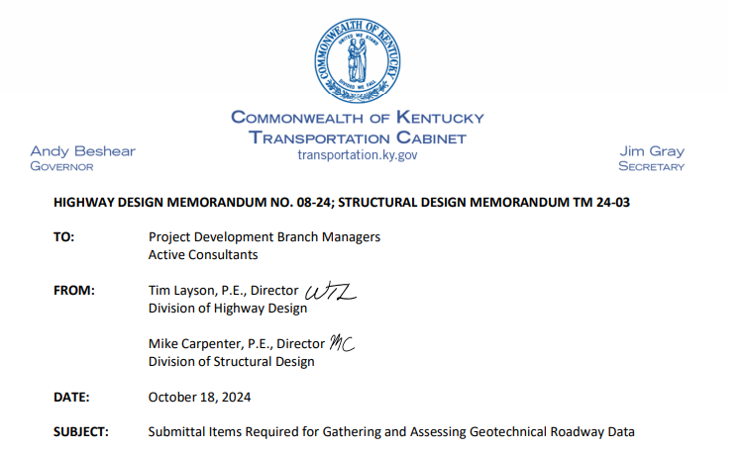
Geotech Update
Memo Follow-Up
Highway Memo No. 8-24: Structural Memo TM 24-03
Submittal Items Required for Gathering and Assessing Geotechnical Roadway Data
  One Year Later
  Consistent, predictable submittals
  Easier file creation
  Less painful plan integration
Thanks For Your Teamwork!
Notes:
About a year ago, we issued Highway Memo 8-24, along with Structural Memo TM 24-03, to outline what’s required for geotechnical roadway data submittals. A year in, we’re really seeing the benefits—submittals are much more consistent and predictable, which makes our job of gathering and assessing data a lot smoother. File creation has gotten easier, and plans are integrating with far less pain. That’s thanks to the effort you all have put in, so we just want to say thank you for the teamwork.

Slide 4

Geotech Update
gINT Replacement Selected (Geotechnical Data base)
Bentley has announced the sunset of gINT January 2026 Support – Extended December 2028
Cabinet has selected EQuIS Geotech as our replacement database
Testing and setup are underway
  Who Does this affect?
  Consultants – No immediate impact
  The data base will accept files from multiple venders including DIGGS
  No new software purchase required for consultants
  KYTC /EQuIS will have a Data Submission Page.
More details to come.
Notes:
“Most of you have probably heard that Bentley is sunsetting gINT. Even though they’ve extended support a little further, we knew we needed a long-term replacement. After looking at several options, we’ve selected EQuIS Geotech as the Cabinet’s new database. Right now, we’re in the testing and setup phase. For consultants, there’s no immediate impact—you don’t need to purchase any new software, and the system will accept files from multiple vendors, including DIGGS. On our side, we’ll be creating a KYTC submission page with EQuIS, so everything can be uploaded directly. We’ll share more details as rollout moves forward.”

Slide 5
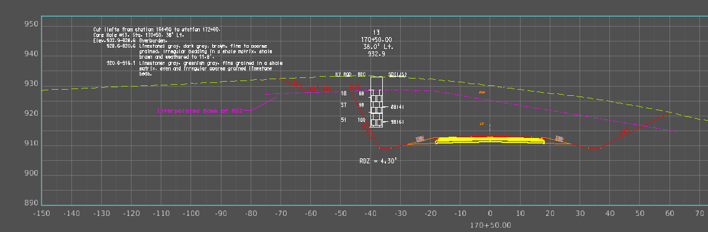
Geotechnical Terrain Challenges
Why are RDZ and other Geotechnical Terrains Challenging to Create ?
  Historically, our software has lacked an effective out-of-the-box method, requiring manual workarounds
  Reliant on the Geologist manually drawing The RDZ and Other Geotechnical Surfaces in the Drawing Model
  Workarounds (profiles from cross sections) rely on straight-line interpolation → oversimplified and less accurate with current core spacing
Notes:
Geotechnical surfaces have always been a challenge. Historically, our software hasn’t had a good out-of-the-box tool for this, so we’ve had to rely on workarounds. In practice, that’s meant the geologist manually drawing the RDZ and other Geotech Surfaces in the drawing model. Another common method has been building profiles from cross sections—but those usually rely on straight-line interpolation, which oversimplifies things. The result is extra effort and less accuracy than we’d like.

Slide 6
Emerging Solutions
Emerging Solutions What do we mean?
  This kind of technology isn’t brand new, but its primary use has been in disciplines other than Roadway— but for KYTC, this is the first time we’ve been able to get hands-on with it, and we’ve only been testing it for a few weeks.
  This is our first test using KYTC data
  We’ve only been working with it for less than a month
  It’s the first hands-on opportunity we’ve had to test technology of this kind
  Results are very preliminary at this stage but look promising
  Testing Less than a Month Old .
Notes:
This technology has been around but mostly used in areas outside of roadway design. For KYTC, this is our very first time getting hands-on with it, and we’ve only been testing it with our data for a few weeks. So, it’s early, but it’s exciting to finally see what it can do for us.

Slide 7



Emerging Solutions
Several vendors now offer tools that can generate RDZ and Other Geotechnical Terrains
  These solutions are still evolving, but they represent a promising shift in how we can manage and visualize subsurface data.
  Vendors currently developing these tools include Carlson Mining, Bentley Leapfrog, and Autodesk has GeoDin Ground, among others
  Several are here in the Vendor Hall to showcase their latest capabilities
  While we are not endorsing a single product at this stage, KYTC is actively exploring these technologies for future workflows
Notes:
We know Geotechnical surfaces have been difficult, but there are some promising developments. Several vendors are now offering tools that can generate RDZ and other geotechnical Terrain’s. These tools are still evolving, but they show real potential in how we manage and visualize subsurface data.
Some of the key players are Carlson Mining, Bentley’s Leapfrog, and Autodesk’s GeoDin Ground—along with others. In fact, several of these vendors are here in the hall today, so you’ll have a chance to see what they’re working on.
Now, just to be clear, we’re not endorsing any one product at this stage. But KYTC is actively exploring these technologies, because we see them as part of our future workflows.

Slide 8
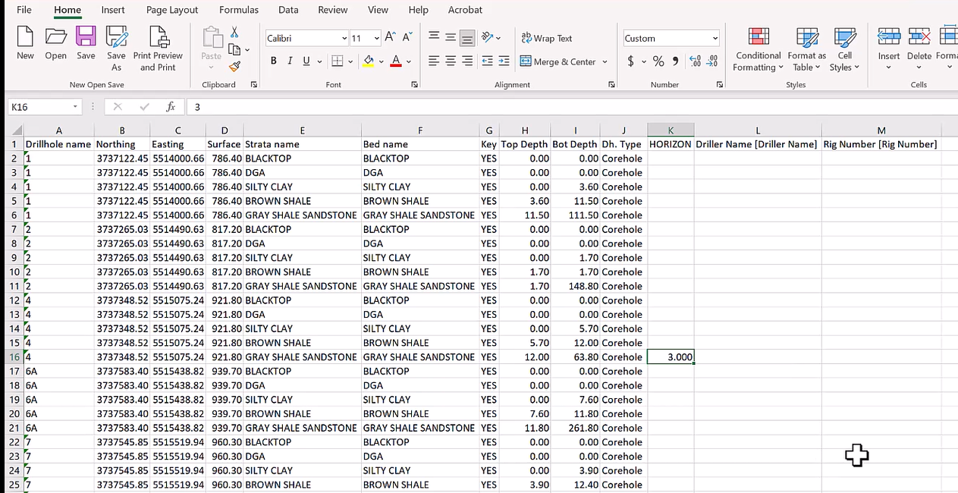
CSV export to Vendors Software
Import method into Software
  Direct CSV export from gINT (as shown)
  Equivalent process achievable with EQuIS
  Multiple Terrains Can Be imported.
Notes:
This is a simple example of how data moves into the vendors software. Multiple Terrains can be imported. What you’re seeing here is a direct CSV export from gINT. The important point is that the same process can be done with EQuIS as well, so we maintain consistency moving forward.

Slide 9
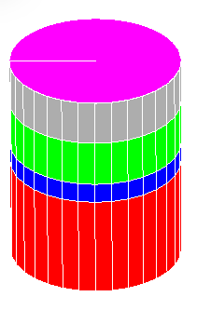
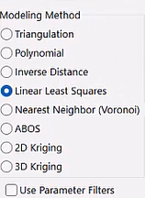
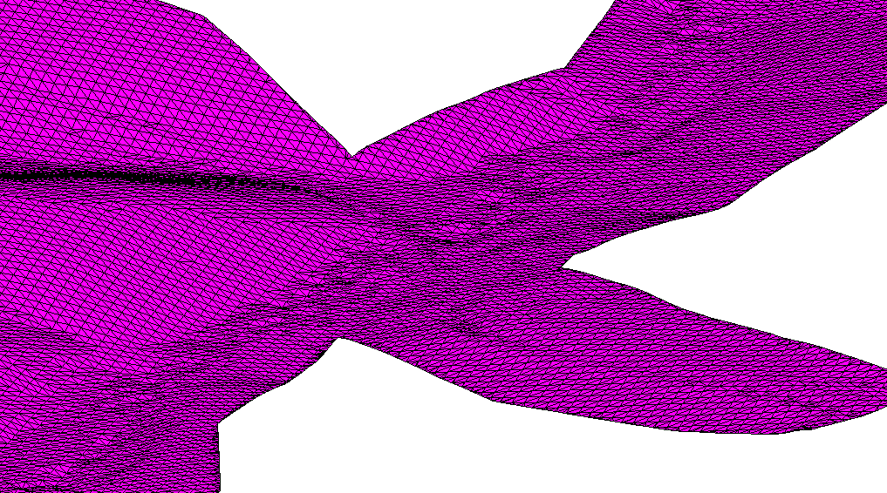
3d Features created in Vendors Software
Exported files
  Multiple Terrains and material types
  Various modeling Methods
  Calculations based on geologic data and existing ground models
  Exported 3D lines that can be quickly built into terrains in OpenRoads
Notes:
The vendor’s software can generate multiple terrains using geologic data and existing ground models. For this RDZ surface, we applied the Linear Least Squares method and exported it directly to a DGN file for use in OpenRoads

Slide 10
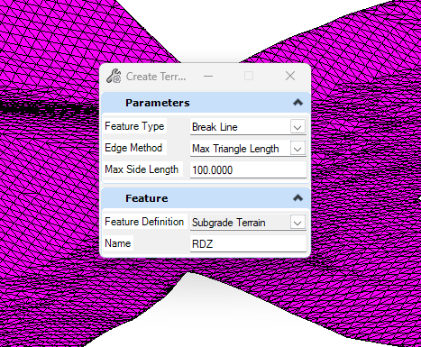
3d Features Imported into OpenRoads
Create a Terrain From Elements
  Feature Type: Break line
  Edge Method: Max. Triangle Length
  Max Side Length: 100
  Feature Definition: Subgrade Terrain
  Name: RDZ
Notes:
In OpenRoads, we select all triangles and create a terrain from elements. For this example, we use Break line, set the edge method to Max Triangle Length with a max side of 100, define it as Subgrade Terrain, and name it RDZ.

Slide 11
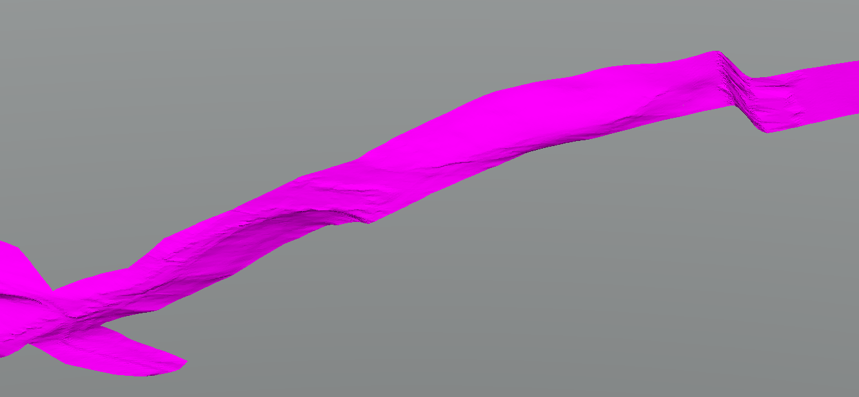
Creating and Managing 3D Surfaces in ORD
Best Practices
RDZ Surface created from break lines
Verify what triangulates in ORD
Split surfaces at corridor start/stop points
Prevent unwanted straight-line connections
Best practices guide coming as tools evolve
Notes:
This surface comes from break lines in ORD. The main thing to watch is the triangulation — if the corridor starts and stops, split it into separate surfaces so you don’t get those straight-line connections. We’re still testing, and we’ll put together best practices once we land on the tool the Cabinet recommends.

Slide 12
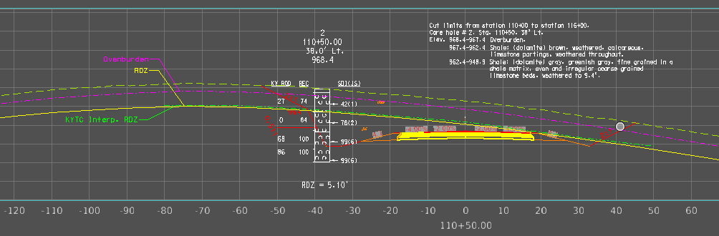
Reference Your Newly Created Terrain in the 3d View
Once the surface is attached to your 3D view, it will appear in both your Drawing and Sheet models Actual 3D terrains.
Notes:
Reference your newly created terrain in the 3D view. Once attached, the surface will appear in both your Drawing and Sheet models as an actual 3D terrain. In this view, the yellow RDZ comes from the newly created surface, while the green RDZ shows the geologist’s interpolated surface. This Software is looking very promising.

Slide 13
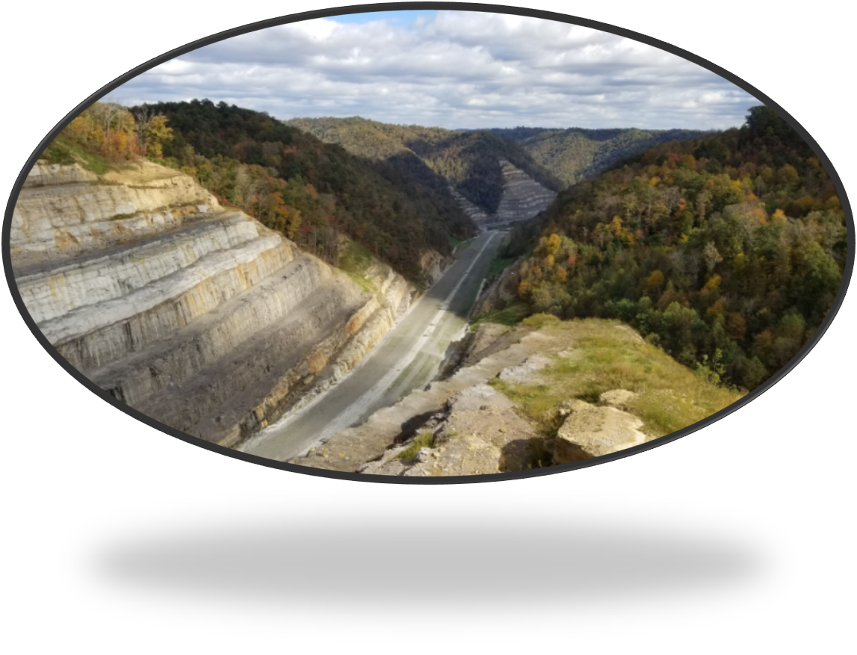
Key Takeaway
While no tool has yet been fully tested for KYTC’s needs, emerging solutions are evolving quickly and show strong potential for future adoption.
  Goal: ensure that we understand the landscape so when the technology matures, we’re ready to adopt what best fits KYTC needs.
  Awareness of these tools is important so we can plan for future integration into our workflows.
Notes:
No tool is fully ready yet, but emerging solutions are evolving fast. Staying aware now ensures KYTC can adopt the best options smoothly when the technology matures
With that I will turn it over to Palmer.

